Slide 1
Events
Remote Event Receivers

Slide 3
How to View This Presentation
To switch to Notes Page view:
On the ribbon, click the View tab, and then click Notes Page
To navigate through notes, use the Page Up and Page Down keys
Zoom in or zoom out, if required
In the Notes Page view, you can:
Read any supporting text—now or after the delivery
Add notes to your copy of the presentation, if required
Take the presentation files home with you

Slide 4
Overview
In this Lesson
Introduction to Remote Event Receivers
Working with SharePoint Data
Security
Creating Remote Event Receivers
Add-In Events

Slide 5
Objectives
Understand the concept of remote event receivers
Learn the different types of remote event receivers
Learn how to create and work with remote event receivers

Slide 6
What are Remote Event Receivers?
Remote Event Receivers (RER) handle events that take place on items
Lists
List Items
Add-Ins
Very similar to event receivers in previous versions of SharePoint
Your web service is called when event is fired instead of executing code within SharePoint
Notes:
What are Remote Event Receivers?
In previous versions of SharePoint, event receivers were often used to perform some action when an event occurred to items in the site. For example when an item is added to a list an event receiver could be used to add an expiration date of one year to the new item.
There are events fired for various items in the SharePoint environment, these items include Lists, List Items, Webs and SharePoint Add-Ins.
In previous versions of SharePoint the event receiver was created as object model code that would be executed on the SharePoint server. In SharePoint 2013 the event receiver has changed this model from executing the code on the server to calling a WCF web service.
When creating a SharePoint Remote Event receiver the developer will have to create the web service that SharePoint will call.
For more information, see: https://docs.microsoft.com/en-us/sharepoint/dev/sp-add-ins/create-a-remote-event-receiver-in-sharepoint-add-ins

Slide 7
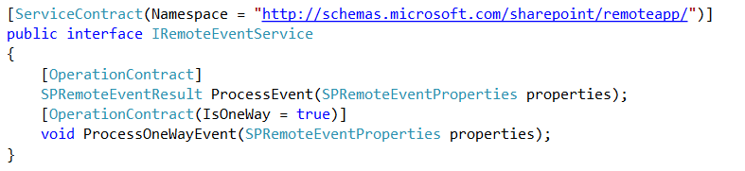
IRemoteEventService Interface
The Remote Event Receiver Web Service implements the IRemoteEventService interface.
ProcessEvent
Synchronous
Before Events
“ing” events
ProcessOneWayEvent
Asynchronous
After Events
“ed” events
Notes:
IRemoteEventService Interface
The Remote Event Receiver web service will implement the IRemoteEventService Interface. The interface code looks like this:
Take note of the two methods defined in this interface, ProcessEvent and ProcessOneWayEvent. These two methods are the what is called when an event is fired. The that is fired depends on the type of event that occurred.
ProcessEvent handles the synchronous events that are called. synchronous events are events that are fired and wait for a response from the web service before continuing. This is similar to the previous version of SharePoint. synchronous events occur before the action has actually completed. The name of synchronous events will end in “ing.”
ProcessOneWayEvent will handle the asynchronous events. These events take place after the event has actually happened and will not wait for the web service call to return any values. Asynchronous event names will end in “ed.”
[ServiceContract(Namespace = "http://schemas.microsoft.com/sharepoint/remoteApp/")]
public interface IRemoteEventService
{
[OperationContract]
SPRemoteEventResult ProcessEvent(SPRemoteEventProperties properties);
[OperationContract(IsOneWay = true)]
void ProcessOneWayEvent(SPRemoteEventProperties properties);
}

Slide 8
Important considerations
Synchronous Remote Event Receivers must take less than 30 seconds to complete
If no response within 30 seconds, SharePoint will call the webservice again
This happens 3 times
After this it will consider it failed and will not try again
The remote event receiver webservices must run on HTTP port 80 or HTTPS port 443
It doesn’t support specifying a custom port
Notes:
For more information, see: https://docs.microsoft.com/en-us/sharepoint/dev/sp-add-ins/create-an-add-in-event-receiver-in-sharepoint-add-ins
Synchronous Remote Event Receivers must complete their execution within 30 seconds. Otherwise SharePoint will consider the call failed and will again call the webservice. This may result in your logic being executed again. It will try this three times and then consider it failed and will never try it again. This doesn’t make it suitable for reliable messaging or processes that are bound to take a longer time. I.e. when provisioning components to the host web in the AppInstallation event, this is typically something that could easily exceed the 30 seconds. An alternative way to do specifically this would be to deploy the components on the first visit of the Add-In. More details on the above mentioned website.
The webservices need to run on port 80 if using HTTP or port 443 if using HTTPS. It is not supported to specify a different port in the webservice URL that should be triggered.

Slide 9
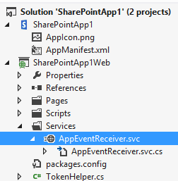
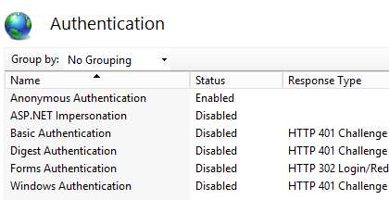
Hosting a Remote Event Receiver
A webservice hosting a Remote Event Receiver can be perfectly hosted in a Provider Hosted Add-In
The webservice endpoint MUST be accessible anonymously as SharePoint will not pass credentials when calling it
An OAuth token is being passed to it which can be used to validate the request and call back into SharePoint
Notes:
Security of the Remote Event Receivers happens via the OAuth token it receives from SharePoint. The webservice itself should be anonymously available for it to work. If somebody would know the webservice address and call it directly, no valid OAuth token would be present, so nothing could happen anyway. Be sure to therefore make use of the token you receive from SharePoint and not use an App-Only context to connect back to SharePoint or other services without having validated the token passed on from SharePoint first.
[ServiceContract(Namespace = "http://schemas.microsoft.com/sharepoint/remoteApp/")]
public interface IRemoteEventService
{
[OperationContract]
SPRemoteEventResult ProcessEvent(SPRemoteEventProperties properties);
[OperationContract(IsOneWay = true)]
void ProcessOneWayEvent(SPRemoteEventProperties properties);
}

Slide 10
List Item Events
Before Events | After Events
ItemAdding | ItemAdded
ItemUpdating | ItemUpdated
ItemDeleting | ItemDeleted
ItemCheckingIn | ItemCheckedIn
ItemCheckingOut | ItemCheckedOut
ItemUncheckingOut | ItemUncheckedOut
ItemAttachmentAdding | ItemAttachmentAdded
ItemAttachmentDeleting | ItemAttachmentDeleted
ItemFileMoving | ItemFileMoved
ItemVersionDeleting | ItemFileConverted
 | ItemVersionDeleted
Notes:
The following pages contain available events for the various scopes. Most names are self explanatory. If more information is needed see:
https://docs.microsoft.com/en-us/sharepoint/dev/sp-add-ins/handle-events-in-sharepoint-add-ins#handle-list-and-list-item-events

Slide 11
List Events
Before Events | After Events
FieldAdding | FieldAdded
FieldUpdating | FieldUpdated
FieldDeleting | FieldDeleted
ListAdding | ListAdded
ListDeleting | ListDeleted
Notes:
For more information, see: https://docs.microsoft.com/en-us/sharepoint/dev/sp-add-ins/handle-events-in-sharepoint-add-ins#handle-list-and-list-item-events

Slide 12
Add-In Events
Before Events | After Events
AppUninstalling | AppInstalled
 | AppUpgraded
Notes:
For more information, see: https://docs.microsoft.com/en-us/sharepoint/dev/sp-add-ins/handle-events-in-sharepoint-add-ins#handle-add-in-events

Slide 13
SharePoint Data in RER Calls
SPRemoteEventResult
Expected to be returned by the RER on Synchronous calls
No need to be concerned about an access token
Data can be updated using this object using the ChangedItemProperties property
Status (Cancel/CancelWithError)
ErrorMessage
SPRemoteEventProperties
Is passed to the RER from SharePoint
EventType
ItemEventProperties.AfterProperties
Notes:
Updating SharePoint Data with RER Calls
Quite often the goal of an RER may be to update some data on an item in SharePoint. It is important to understand when and how this can be done.
SPRemoteEventResult
If the RER is a Synchronous event, then SharePoint expects a SPRemoteEventResult object to be returned. This object contains a ChangedItemProperties property. This object is actually a Dictionary object. Any items that are added to this object will be updated in SharePoint upon return of the SPRemoteEventResult object as long as it matches one of the properties of the object.
Often a developer may want to validate some data, and then cancel then the event if the validation fails. To do this use the Status property of the SPRemoteEventResult. It can be set to three values: Continue, CancleNoError and CancelWithError. The important thing to understand here is CancelWithError, as this gives SharePoint an opportunity to explain to the user why the cancel happened. By setting the ErrorMessage property of the SPRemoteEventResult to a message for the user, and then setting the Status to CancelWithError when this is returned to SharePoint it will display that error message to the user.
SPRemoteEventProperties
ItemEventProperties.BeforeProperties/ItemEventProperties.AfterProperties can be checked in some scenarios for data validation and for cancelling operations in the event of failure
result.ChangedItemProperties.Add(“_Status”, “Draft”);

Slide 14
SharePoint Data outside RER Calls
Update Data in other areas of SharePoint
Use TokenHelper class to get a token
Make updates as needed using CSOM or one of the REST endpoints
Example:
List1 has fired an event and is configured with a remote event receiver
SharePoint calls into the RER, which determines that an update needs to be made on List2
In order to make the update to List2, the RER needs an access token
Notes:
SharePoint Data Outside of RER Calls
Quite often data that is outside of what is passed to us may need to be updated. For example when one list is updated in SharePoint it is possible that the developer may want to update something in another list. This can be done pretty simply by using the TokenHelper class provided by the Office Developer Tools for Visual Studio.
The TokenHelper will be discussed in a little more detail later in this module.

Slide 15

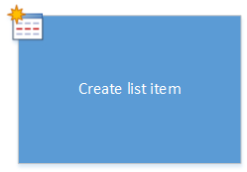
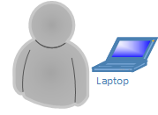
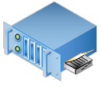
Remote Event Receivers
Simple Remote Event Receiver Call
Custom Web Service
3. RER Called
1. User Makes Change
4. Synchronous Event Returns
SharePoint
Server-to-Server STS or ACS
2. Requests Token
User
Notes:
Simple Remote Event Receiver Call
1. User takes some action in SharePoint causing the RER to fire.
2. SharePoint then asks either ACS or S2S STS for a token. This token is then passed in the call to the RER.
3. SharePoint calls the Event Receiver Web Service and passes the context token. The web service validates the signature on the context token and extracts the authorization code
4. The Event Receiver code is executed
5. The Event receiver web service returns the SPRemoteEventResult object for synchronous events.

Slide 16
Remote Event Receivers
5. SharePoint Updated
Advanced Remote Event Receiver Call
Custom Web Service
3. RER Called
1. User Makes Change
4. Requests Token to
Update SharePoint
SharePoint
2. Requests Token
User
Notes:
Advanced Remote Event Receiver Call
User takes some action in SharePoint causing the RER to fire.
SharePoint then asks either ACS or S2S STS for a token. This token is then passed in the call to the RER.
SharePoint calls the Event Receiver Web Service and passes the context token. The web service validates the signature on the context token and extracts the authorization code
The Event Receiver code is executed
If the code wants to make changes in SharePoint it must request a token from either ACS or the S2S STS.
Changes made in SharePoint via CSOM or some other process.

Slide 17
High-Level Overview RER Development
Build the WCF service which can be called as a Remote Event Receiver
Implement the IRemoteEventService interface
Register the webservice to be called at specific Add-In event(s)
When the event(s) occur, the webservice is triggered
Notes:
What are Remote Event Receivers?
In previous versions of SharePoint, event receivers were often used to perform some action when an event occurred to items in the site. For example, when I an item is added to a list an event receiver could be used to add an expiration date of one year to the new item.
There are events fired for various items in the SharePoint environment, these items include Lists, List Items, Webs and SharePoint 2016 Add-Ins.
In previous versions of SharePoint the event receiver was created as object model code that would be executed on the SharePoint server. In SharePoint 2013 the event receiver has changed this model from executing the code on the server to calling a WCF web service.
When creating a SharePoint 2016 remote event receiver the developer will have to create the web service that SharePoint will call.

Slide 18
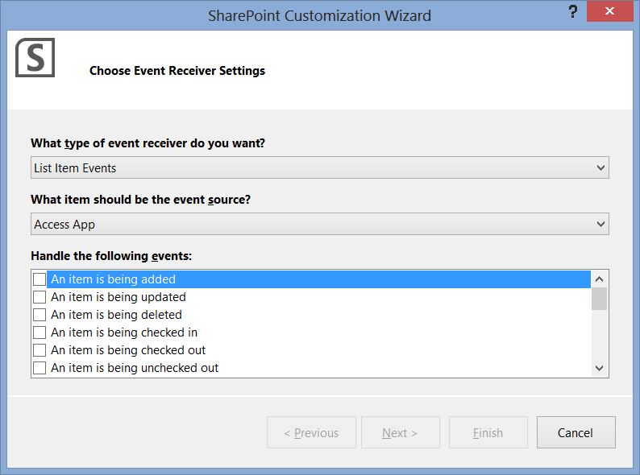
RER Customization Wizard
Notes:
Remote Event Receiver Customization Wizard
It is simple to add a RER to a SharePoint Add-In. Select the SharePoint Add-In project in Visual Studio 2012. Select Add→New Item. Once the select new item box appears select Remote Event Receiver from the SharePoint/Office section.
Once the selection above has been chosen the RER Customization Wizard will start. This wizard is very easy to use select the type of RER to create, either List Item Event or List Event. Then select the events that should be handled by checking the check box next to that item.

Slide 19
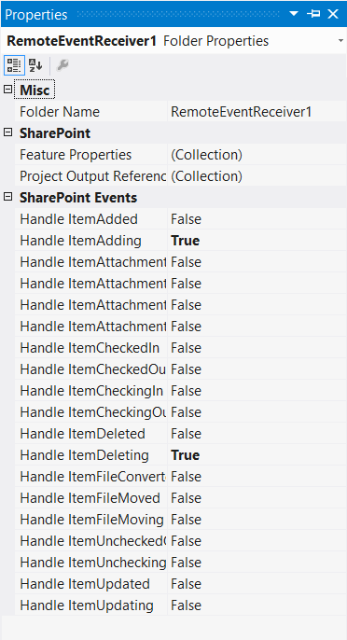
RER Customization Wizard
Once the wizard has been closed use the properties of the RER object to register new events
Set the property that is to be handled to true
This will update the elements.xml file
Notes:
Once the Customization Wizard has been closed it may seem difficult to add new events to the RER. In fact it is quite simple, just use the properties window of the RER item. There you can set the Events that should be handled to true. What really happens when these properties are set to true it changes the elements.xml file and the entries to register the other events. The elements.xml file will be discussed on the next page.

Slide 20
RER Customization Wizard
Events registered through the Visual Studio wizard only apply to events within the AppWeb, not the HostWeb
To create event receivers on the HostWeb, use CSOM in the AppInstalled event to register the event receiver
var receiver = new EventReceiverDefinitionCreationInformation()
{
EventType = EventReceiverType.ItemAdded,
ReceiverUrl = System.ServiceModel.OperationContext.Current.RequestContext.RequestMessage.Headers.To.ToString(), ReceiverName = "ItemAdded Event",
Synchronization = EventReceiverSynchronization.Synchronous
};
list.EventReceivers.Add(receiver);
Notes:
The code on this slide is handling the AppInstalled event… basically when the SharePoint Add-In is installed to the hostweb, then this event would fire which reaches back into sharepoint using CSOM to register a new event receiver on the Host web at the desired location/eventtype.

Slide 21
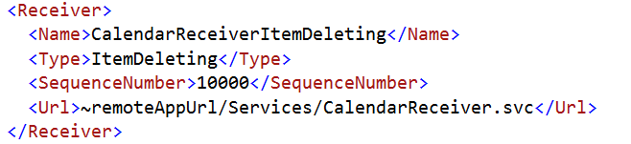
Elements.xml
When an RER is created an elements.xml file is added.
The elements.xml file is used to register the event receivers
Notes:
Elements.xml
The elements.xml is how SharePoint will know about the RERs. This is called registering the RER. The <receivers> tag will contain all of the <receiver> registrations for each event to be handled. Within those tags the Name, Type and Url of the RER will be listed.
The receiver element of this file is very similar to the receiver element in SharePoint 2010 elements.xml. The only difference being the addition of the Url tag and removing the Assembly and Class tags.
Registering events can also be done via code. This may be needed when you want to register the event on something that already exists and is not part of the current SharePoint Add-In.
string url= "http://<URL to receiver>/RemoteEventService.svc";
using (SPSite site = new SPSite(siteUrl))
{
using (SPWeb web = site.RootWeb)
{
SPList list = web.Lists[listTitle];
list.EventReceivers.Add(
SPEventReceiverType.ItemAdded, url);
}
}

Slide 22
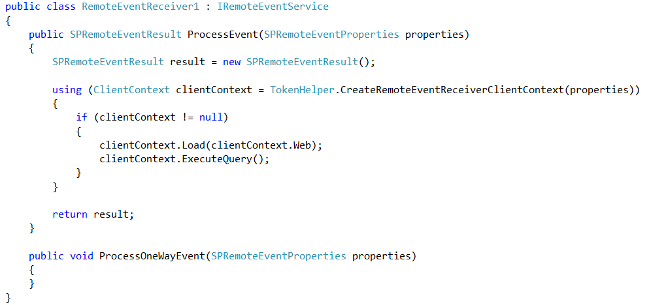
The RER Web Service
A Web Service file (.svc) will be added to the Web Application in the SharePoint Add-In
If a Web Application does not exist one will be created
This file is where all RER code will be written
Notes:
The RER Web Service
Once the RER has been created, a web service .svc file will be added to the web Application in the project. Visual Studio 2012 will add quite a bit of functionality to it. Notice the code snippet:
using System;
using System.Collections.Generic;
using System.Linq;
using System.Text;
using Microsoft.SharePoint.Client;
using Microsoft.SharePoint.Client.EventReceivers;
namespace SharePointApp3Web.Services
{
public class RemoteEventReceiver1 : IRemoteEventService
{
public SPRemoteEventResult ProcessEvent(SPRemoteEventProperties properties)
{
SPRemoteEventResult result = new SPRemoteEventResult();
using (ClientContext clientContext = TokenHelper.CreateRemoteEventReceiverClientContext(properties))
{
if (clientContext != null)
{
clientContext.Load(clientContext.Web);
clientContext.ExecuteQuery();
}
}
return result;
}
public void ProcessOneWayEvent(SPRemoteEventProperties properties)
{
}
}
}

Slide 23
The RER Web Service
One RER WCF service can handle multiple types of events:
public SPRemoteEventResult ProcessEvent(SPRemoteEventProperties properties)
{
SPRemoteEventResult result = new SPRemoteEventResult();
switch(properties.EventType)
{
case SPRemoteEventType.AppInstalled:
// Do something
break;
case SPRemoteEventType.AppUninstalling:
// Do something else
break;
case SPRemoteEventType.ItemAdded:
// Do yet another something
break;
}
return result;
}
Notes:
using System;
using System.Collections.Generic;
using System.Linq;
using System.Text;
using Microsoft.SharePoint.Client;
using Microsoft.SharePoint.Client.EventReceivers;
namespace SharePointApp3Web.Services
{
public class RemoteEventReceiver1 : IRemoteEventService
{
public SPRemoteEventResult ProcessEvent(SPRemoteEventProperties properties)
{
SPRemoteEventResult result = new SPRemoteEventResult();
using (ClientContext clientContext = TokenHelper.CreateRemoteEventReceiverClientContext(properties))
{
if (clientContext != null)
{
clientContext.Load(clientContext.Web);
clientContext.ExecuteQuery();
}
}
return result;
}
public void ProcessOneWayEvent(SPRemoteEventProperties properties)
{
}
}
}

Slide 24
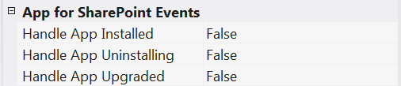
Add-In Level RER
No option in the RER Customization Wizard for creating Add-In level RERs
They fire outside of the normal SharePoint event infrastructure
Handled at the App Manifest level
Notes:
Add-In Level RER
When creating a RER we have the handy RER customization wizard available for List and ListItem events. But what about Add-In level events? Well these events are handled at a different level we want to call them when the Add-In is installed, uninstalled or updated. Therefore this must be handled at the App Manifest level.
Adding a Add-In level RER is very simple.
Click on the Add-In project in Visual Studio 2015.
In the properties window for the find the Add-In for SharePoint Events section.
Set the events that you would like to handle to true.
The code for an Add-In level event will be written in the ProcessEvent or ProcessOneWayEvent. They can be synchronous or asynchronous and use the OAuth functionality as well.

Slide 25
Knowledge Check
For which types of objects are the remote event receivers available?
Can you use the remote event receiver wizard in Visual Studio to add an event receiver for installing Add-Ins?
The IRemoteEventService interface
No. The Add-In remote event receivers are handled at the App Manifest level. They can be added via the properties of the Add-In project in Visual Studio.
Lists
What interface should the remote event receiver web service implement?
List Items
Add-In installation/upgrades/uninstallation

Slide 26
Lesson Summary
RERs can be used to act upon changes in SharePoint Online
The functionality that gets triggered is hosted outside of SharePoint in a webservice
The webservice needs to implement a Microsoft SharePoint specific interface

Slide 27
Questions?

Slide 28
Lab: Remote Event Receivers
In this lab you’re going to create a Remote Event Receiver on both the Add-In Web as well as on the Host Web and have it call your service when an event occurs.
Time estimation: 45 minutes
Notes:
Lab content can be found under “Lab - Remote Event Receivers”

